Slide 1
Tesla Pump
Design Review 4
Patrick Duggan, Eric Goff, Garrett Hart
2/27/2018
Team 12

Slide 2
Design Team
Eric Goff
Patrick Duggan
Team Leader
Eric Goff
Secretary
Garrett Hart
Treasurer
Thomas Kline
Lead ME
Christopher Salim
Design Coordinator
Project Advisors:
James Martin
James Smith
Faculty Advisors:
Shayne McConomy, PhD
Chiang Shih, PhD
Lance Cooley, PhD

Slide 3
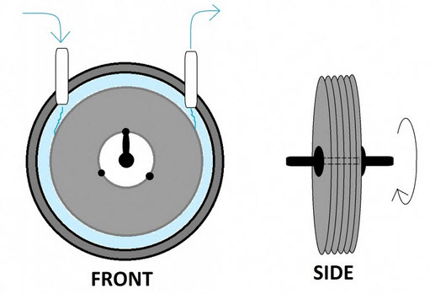
Tesla Pump Recap
Eric Goff
Stacked Disks
Series of flat disks with inner holes that spin due to a motor
Fluid enters around center of disks and centripetally moves outward
The boundary layer effect that occurs between the disks propels the fluid
Increasing rotational speed will increase centripetal force
Figure 1. Tesla Pump System [2]
Notes:
Just to recap, we have been working on a Tesla Pump, which is a series of flat disks with a shaft through the center, which is connected to a motor that causes the system to spin. The disks are enclosed in a housing, and fluid flows in through an inlet in the center, and flows through holes placed on the disks, and move centripetally outward. What propels the fluid outward is the boundary layer effect, which is a phenomenon caused by the fluid’s viscosity. The part of the fluid directly in contact with the edges of the disks attaches, and the centripetal force of the spinning disks forces the fluid out. As more fluid flows in, the fluid already in the system is also pushed normal to the disks as well. The centripetal force that pushes the fluid out is directly proportional to the motor’s rotational speed.

Slide 4
Tesla Pump Recap
Eric Goff
Stacked Disks
Series of flat disks with inner holes that spin due to a motor
Fluid enters around center of disks and centripetally moves outward
The boundary layer effect that occurs between the disks propels the fluid
Increasing rotational speed will increase centripetal force
Inlet
Figure 1. Tesla Pump System [2]

Slide 5
Tesla Pump Recap
Eric Goff
Outlet
Stacked Disks
Series of flat disks with inner holes that spin due to a motor
Fluid enters around center of disks and centripetally moves outward
The boundary layer effect that occurs between the disks propels the fluid
Increasing rotational speed will increase centripetal force
Inlet
Housing
Figure 1. Tesla Pump System [2]

Slide 6
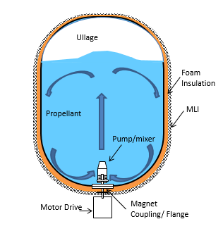
Tesla Pump Recap
Eric Goff
Used for mixing and transporting cryogenic fluid (Liquid Nitrogen and Oxygen)
Size of tank and type of fluid defines the 15 gpm and 5 psi rise targets
Mixing will help reduce stratification within the fluid as well as disperse thermal energy
Pump shall also be robust and be able to transfer fluid from one tank to another depending on needed application
Figure 2. Propellant Mixing [3]
Notes:
NASA wants to develop a tesla pump that is capable of mixing and transporting cryogenic fluid which can be used to fuel spacecraft. However, our main goal is to make this work with water, with cryogenic materials being a bonus. Our goals of 15 gallons per minute and 5 psi pressure rise are for water specifically. The mixing maximizes the effectiveness of the fluid by preventing stratification, and the pump should also be able to transfer the fluid from one tank to another if needed.

Slide 7
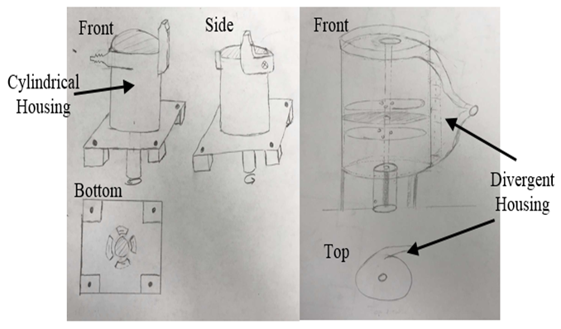
Concept Selection
Eric Goff
Housing
Made with Stainless Steel 316 L
Divergent design ideally desired - manufacturing limitations
Unable to feasibly cast a quantity of 1
NASA unable to 3D print design
Resulting in cylindrical-like housing
Use tube as a main housing piece
Remove material from side to weld on metal pieces to better guide fluid flow – similar to divergent housing
Thicker metal to minimize warping due to extreme temperatures while welding
Figure 3. Housing Concepts
Notes:
We were originally pondering between a design that had two bearings; one at the top and one at the bottom of the housing, and then a cantilever design, where there are two bearings below the housing, one connecting the housing to the shaft, and another connecting the shaft to the tank.

Slide 8
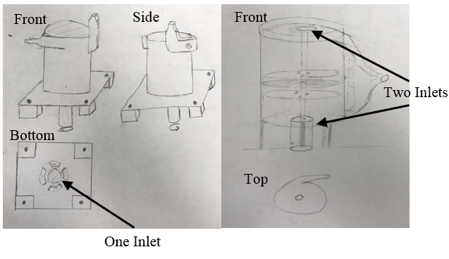
Concept Selection
Eric Goff
2 Inlets – 1 Outlet
Maximize fluid intake at center of disk stack with 2 inlets
2 Bearings & 1 Shaft Seal
Minimize friction and provide shaft support
Prevent fluid leaking from tank
Vary disk spacing by varying quantity of thin spacers between disks
1 size of spacers, add more to increase spacing
Reduce different materials required to order
Figure 4. Inlet Concepts
Notes:
Originally, we selected a divergent style housing, which gradually increases the radius of curvature of the outlet, as opposed to a steep 90 degree bend in the cylindrical style housing. This allows for a smoother transition and less pressure loss while exiting the pump.
However, we are no longer leaning towards this, as we have discovered that it will be difficult to weld a design like this with stainless steel. We will still attempt it, but the simpler Cylindrical style housing is looking more feasible.
To recap, we chose stainless steel (316SS) over aluminum due to its increased capabilities in handling cryogenic fluids, since the lowest operating temperature for aluminum was reported higher than that of the boiling point on nitrogen, making liquid nitrogen unusable in this project.

Slide 9
Presenting Next
Garrett Hart
Finalized Design & Components

Slide 10
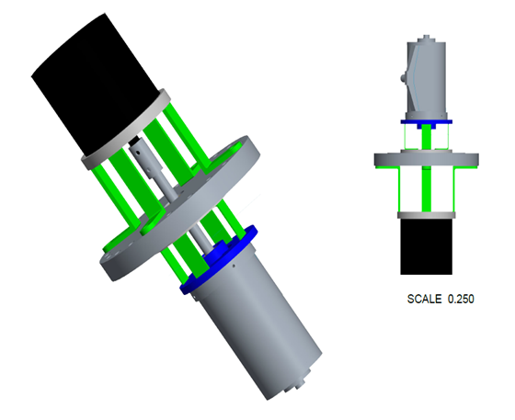
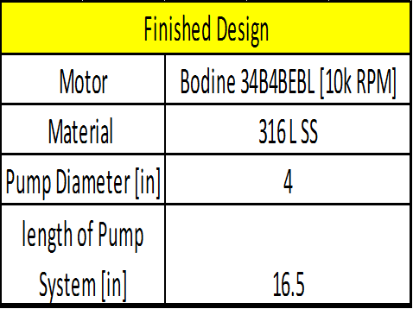
Finished Tesla Pump Design
Garrett Hart
Table 1. Finished Design Information
Motor
Pump
Figure 5. Final Design CAD Image

Slide 11
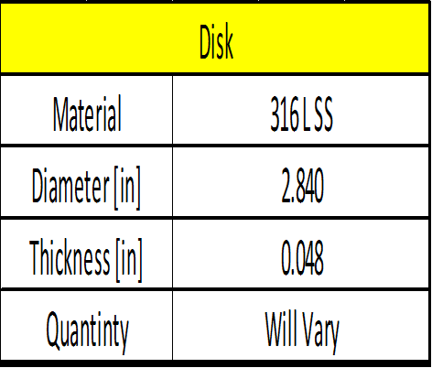
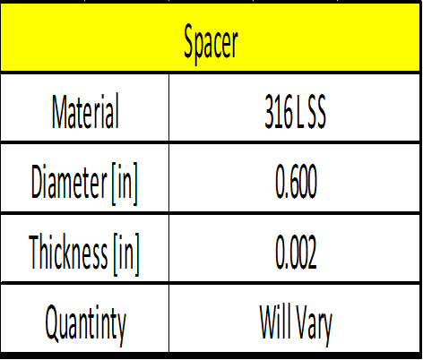
Disks and Spacers
Garrett Hart
Table 2. Disk Information
Table 3. Spacer Information

Slide 12
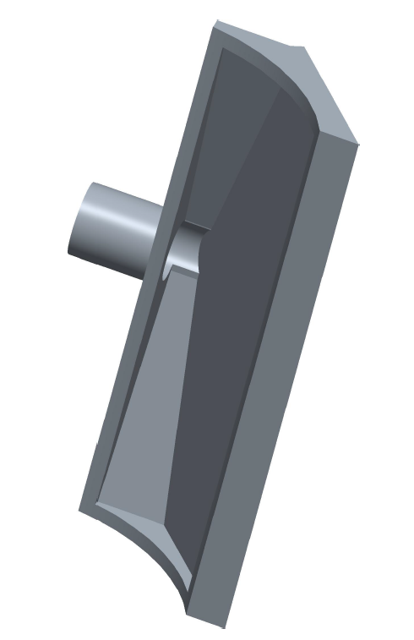
Outlet Nozzle
Garrett Hart
Modified outlet nozzle to better fit our needs
Will be using a 0.5 inch nipple attachment
The nozzle is still diverging to help direct flow
Figure 6. Outlet Nozzle

Slide 13
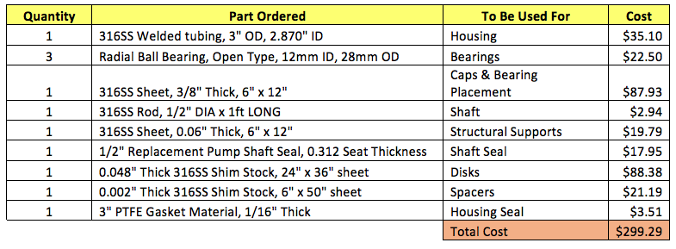
Parts and Material
Garrett Hart
Table 4. Materials Ordered To Manufacture Design

Slide 14
Presenting Next
Patrick Duggan
Test Rig Development & Project Plan

Slide 15
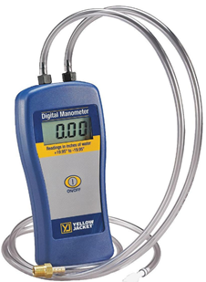
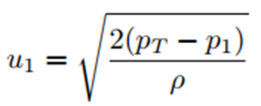
Test Rig Development
Patrick Duggan
The goal of the test rig is to work in different mediums in order to reach our intended 15 gpm and 5 psi pressure rise.
Test 1: Ensure design is operational
Pump will be initially tested in air
Pump will use a standard manometer to gauge the pressure rise created
Fluid velocity can be calculated using the measured pressure seen in Equation 1
Figure 6. Manometer
Eq. 1

Slide 16
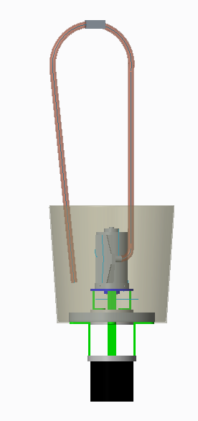
Test Rig Development
Patrick Duggan
Test 2: Gather data with water to develop performance relationships
Testing with water will require a more developed test rig
Design will involve submerging the pump into a tank
Gaskets and seals to prevent leaks
Test Rig
Tank filled with water, pump connected through hole in the bottom
Outlet nozzle connected to flexible hose that will recirculate back into tank
Figure 7. Test Rig

Slide 17
Testing Liquid
Patrick Duggan
The application of the pump will use Liquid Nitrogen however due to safety concerns and difficulty of testing, different fluids are being explored.
Air and water are decent fluids for initial testing however the density and viscosity of both are very different that Liquid Nitrogen.
Testing Fluids
Fluid | Density [kg/m^3] | Boiling Temp [C] | Viscosity[N*s/m^2]
Air | 1.225 | -194.3 | 0.000018
Water | 1000 | 100 | 0.000890
Nitrogen | 808.4 | -195.8 | 0.000156
Hexane | 654.8 | 25 | 0.000297
Acetone | 784.6 | 25 | 0.000316
Propane | 493.5 | -40 | 0.000110
Acetone is readily available, easy to handle and safe.

Slide 18
Project Plan
Patrick Duggan
Current Work
Parts are starting to arrive so the manufacturing process can begin
Disks and spacers are going to be cut with the water jet
Housing caps are to be welded to the large cylindrical tubing
Nozzle attachment is to be welded together from smaller pieces
Future Work
Ensure that the pump works and moves fluid
Build the test rig
Collect data from different and fluids varied disk spacing

Slide 19
References
[1] Dr. Guha, Tufan. “Rectanguar Jet_Lecture Notes.” Thermal Fluids Class. Thermal Fluids Class, Tallahassee, FAMU- FSU College of Engineering.
[2] “Tesla Turbine.” TurbineGenerator, TurbineGernerator, 20 Dec. 2016,
turbinegenerator.org/tesla-turbine/.
[3]“What Is Radial Load and Axial Load?” Quora, Kaydon Bearing Solutions, www.quora.com/What-is-radial-load-and-axial-load.
[4]“Failure Analysis of a Half-Shaft of a Formula SAE Racing Car.” Case Studies in Engineering Failure Analysis, Elsevier, 9 May 2016, www.sciencedirect.com/science/article/pii/S2213290216300086.
[5] “Bearings.” Motion Industries, Motion Industries, www.motionindustries.com/taxonomy/Bearings/browse/en.
Notes:
https://www.ksb.com/centrifugal-pump-lexicon/noise-in-pumps-and-systems/191140/

Slide 20
Questions ?
Testing Fluids
Fluid | Density [kg/m^3] | Boiling Temp [C] | Viscosity[N*s/m^2]
Air | 1.225 | -194.3 | 0.000018
Water | 1000 | 100 | 0.000890
Nitrogen | 808.4 | -195.8 | 0.000156
Hexane | 654.8 | 25 | 0.000297
Acetone | 784.6 | 25 | 0.000316
Propane | 493.5 | -40 | 0.000110

